Slide 1
CSIRO Image2Biomass: Precision Agriculture through Foundation Models
Optimizing Pasture Management with DINOv2 and GBDT Architectures
Presenter: Hamza Bin Abdul Majeed
Date: 16 January 2026

Slide 2
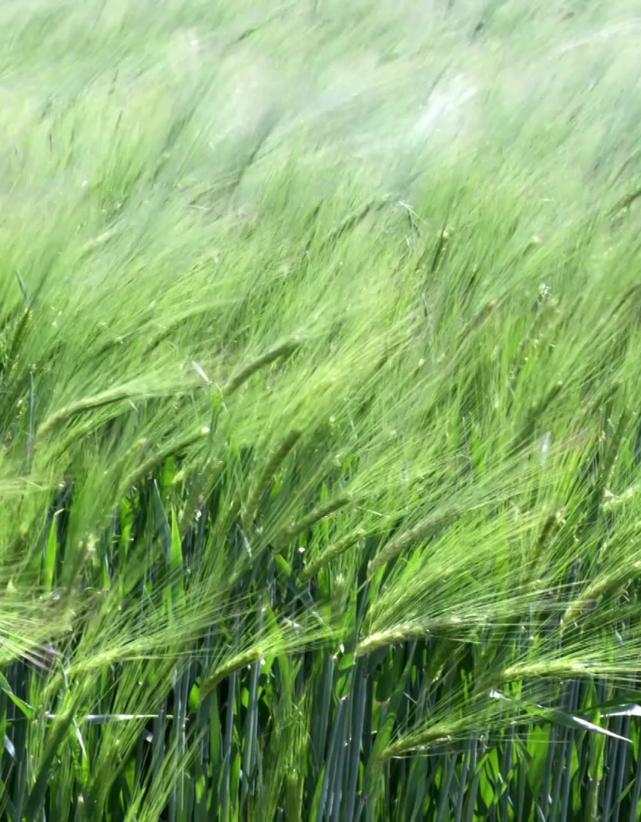
Introduction
The Problem: Traditional "clip-and-weigh" biomass estimation is destructive, labor-intensive, and impossible to scale across vast grazing lands.
The Challenge: Estimating fine-grained biomass components (Green, Dead, Clover) from top-view RGB imagery is difficult due to visual overlaps and lighting variances.
The Opportunity: AI-driven computer vision provides a non-destructive, real-time solution for farmers to assess feed availability.

Slide 3

Project Objectives
Technical Goal: Develop a robust multi-target regression pipeline for 5 key biomass metrics:
Dry_Green_g, Dry_Dead_g, Dry_Clover_g, GDM_g, and Dry_Total_g.
Experimental Goal: Benchmark custom CNN architectures against state-of-the-art foundation models.
Performance Goal: Achieve a high Weighted R^2 score to meet competition standards (emphasizing Total Biomass).

Slide 4
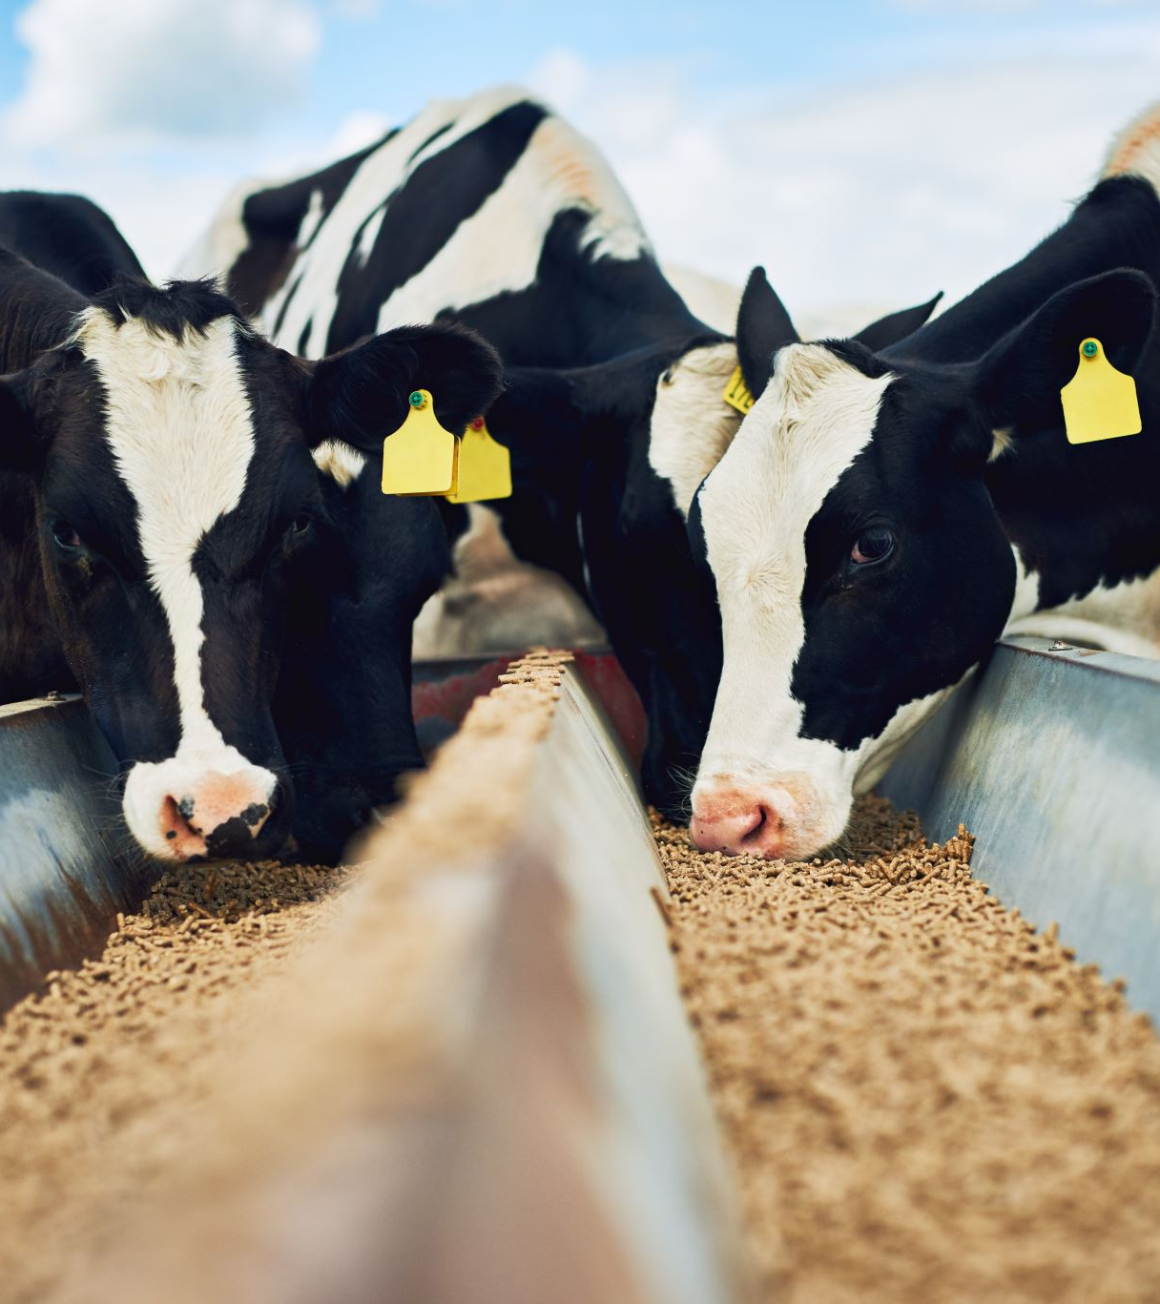
Alignment with UN SDGs
SDG 2 (Zero Hunger): Increases agricultural productivity and livestock resilience through optimized feed management.
SDG 12 (Responsible Production): Minimizes feed waste and optimizes land use in pasture-based livestock systems.
SDG 15 (Life on Land): Prevents overgrazing and land degradation, preserving soil health and biodiversity across Australian ecosystems.

Slide 5
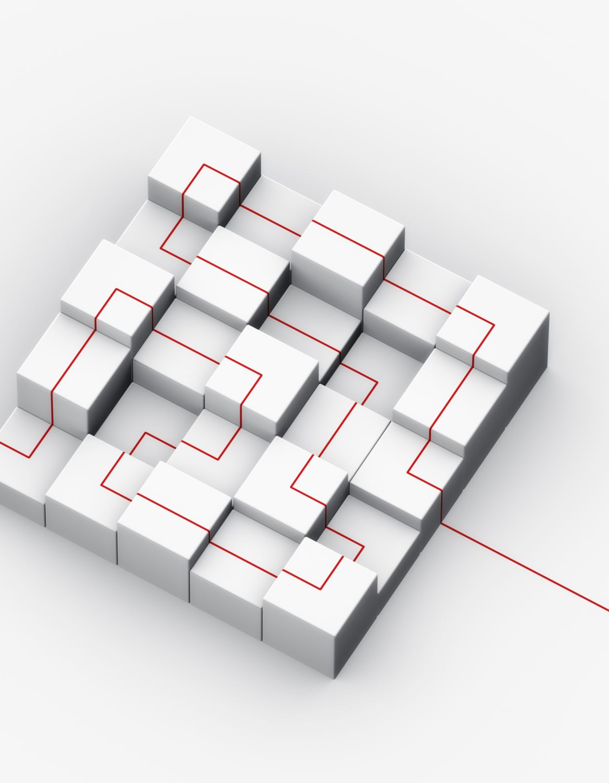
Methodology – Phase 1: Custom CNN
Architecture: 3-block CNN utilizing 3x3 kernels and Batch Normalization.
Key Findings: Deeper models (4+ blocks) led to rapid overfitting.
Regularization: A high Dropout rate of 0.6 was mandatory for validation stability.
Baseline Performance: Achieved a peak Weighted R^2 of 0.3201.

Slide 6

Methodology – Phase 2: DINOv2 + GBDT
The Breakthrough: Shifted from training backbones to utilizing Meta’s DINOv2 (Vision Transformer).
Feature Extraction: * Extracted frozen patch-level embeddings to capture spatial texture.
Averaged patch features into a global descriptor.
Regressor: Trained CatBoost on extracted features using a 5-fold cross-validation strategy.
Result: Performance increased significantly to 0.6289 Weighted R^2.

Slide 7
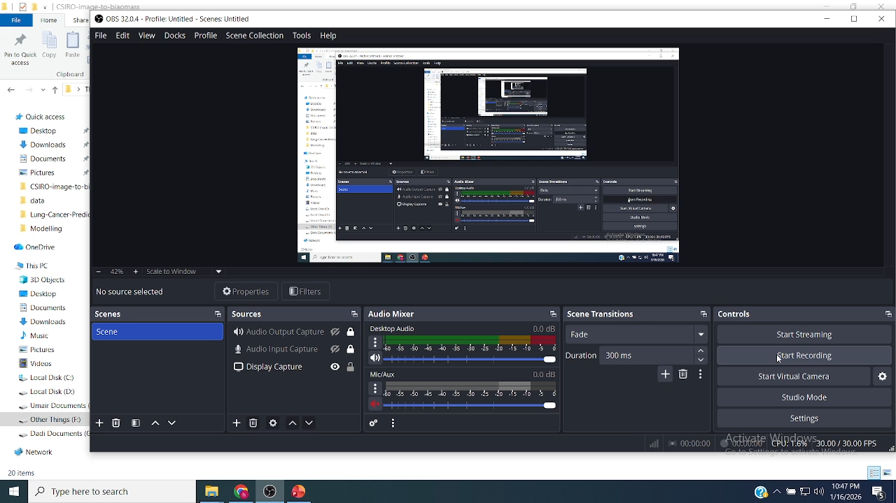

Slide 8
Results & Comparison
Approach | Best Validation R2 | Gain
Custom CNN Baseline | 0.2515 | -
Optimized CNN | 0.3201 | +27%
DINOv2 + CatBoost | 0.6289 | +150%
Insight: Foundation models pre-trained on diverse datasets understand plant textures far better than CNNs trained from scratch on small agricultural samples.

Slide 9
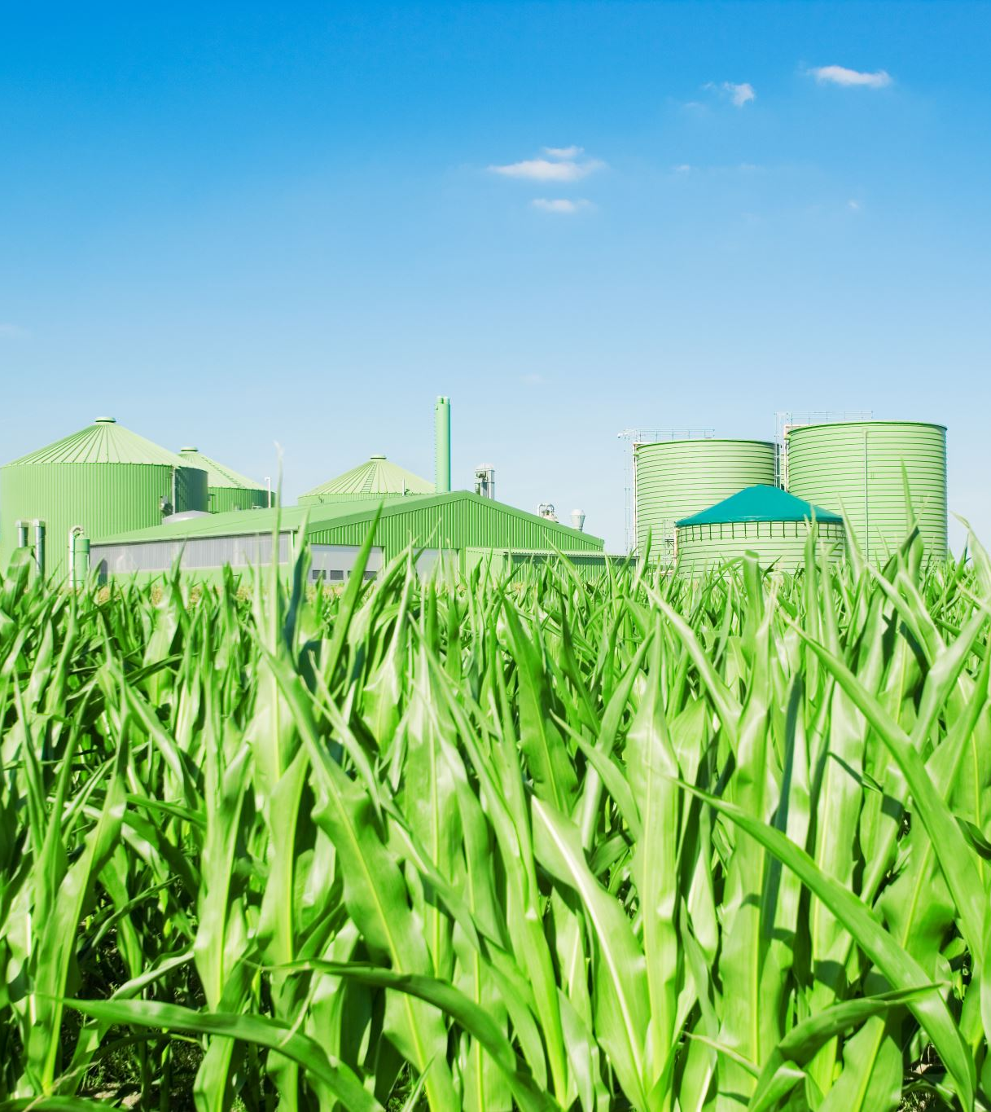
Conclusion
Summary: The project successfully established that foundation model features are superior to custom CNNs for biomass regression.
Final Model: The DINOv2 + CatBoost pipeline is stable, scalable, and achieves high accuracy for the most critical biomass targets.
Future Work: Fine-tuning the DINOv2 backbone specifically on agricultural datasets (Bio-DINO) to further push the R^2 boundary.

Slide 10

Q&A
Thank you for your attention!
Questions?
Contact:
Email:hamzamusabutt@gmail.com
Github:https://github.com/Hamzabinabdulmajeed
Kaggle:https://www.kaggle.com/hamzabinbutt
Youtube:https://www.youtube.com/playlist?list=PLXYJkDoMHHQ3xrqp7b2CKQxB6QcrfqCBc

